Slide 1
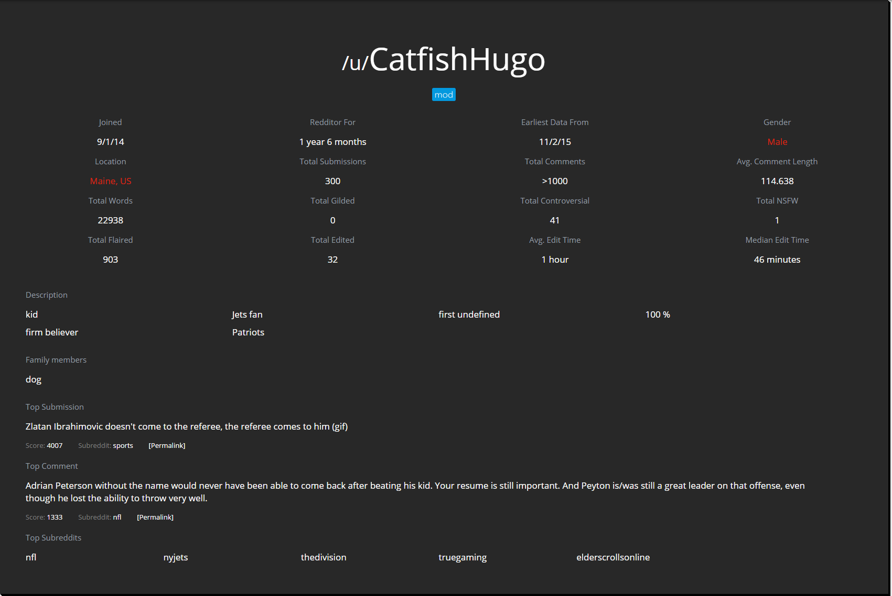
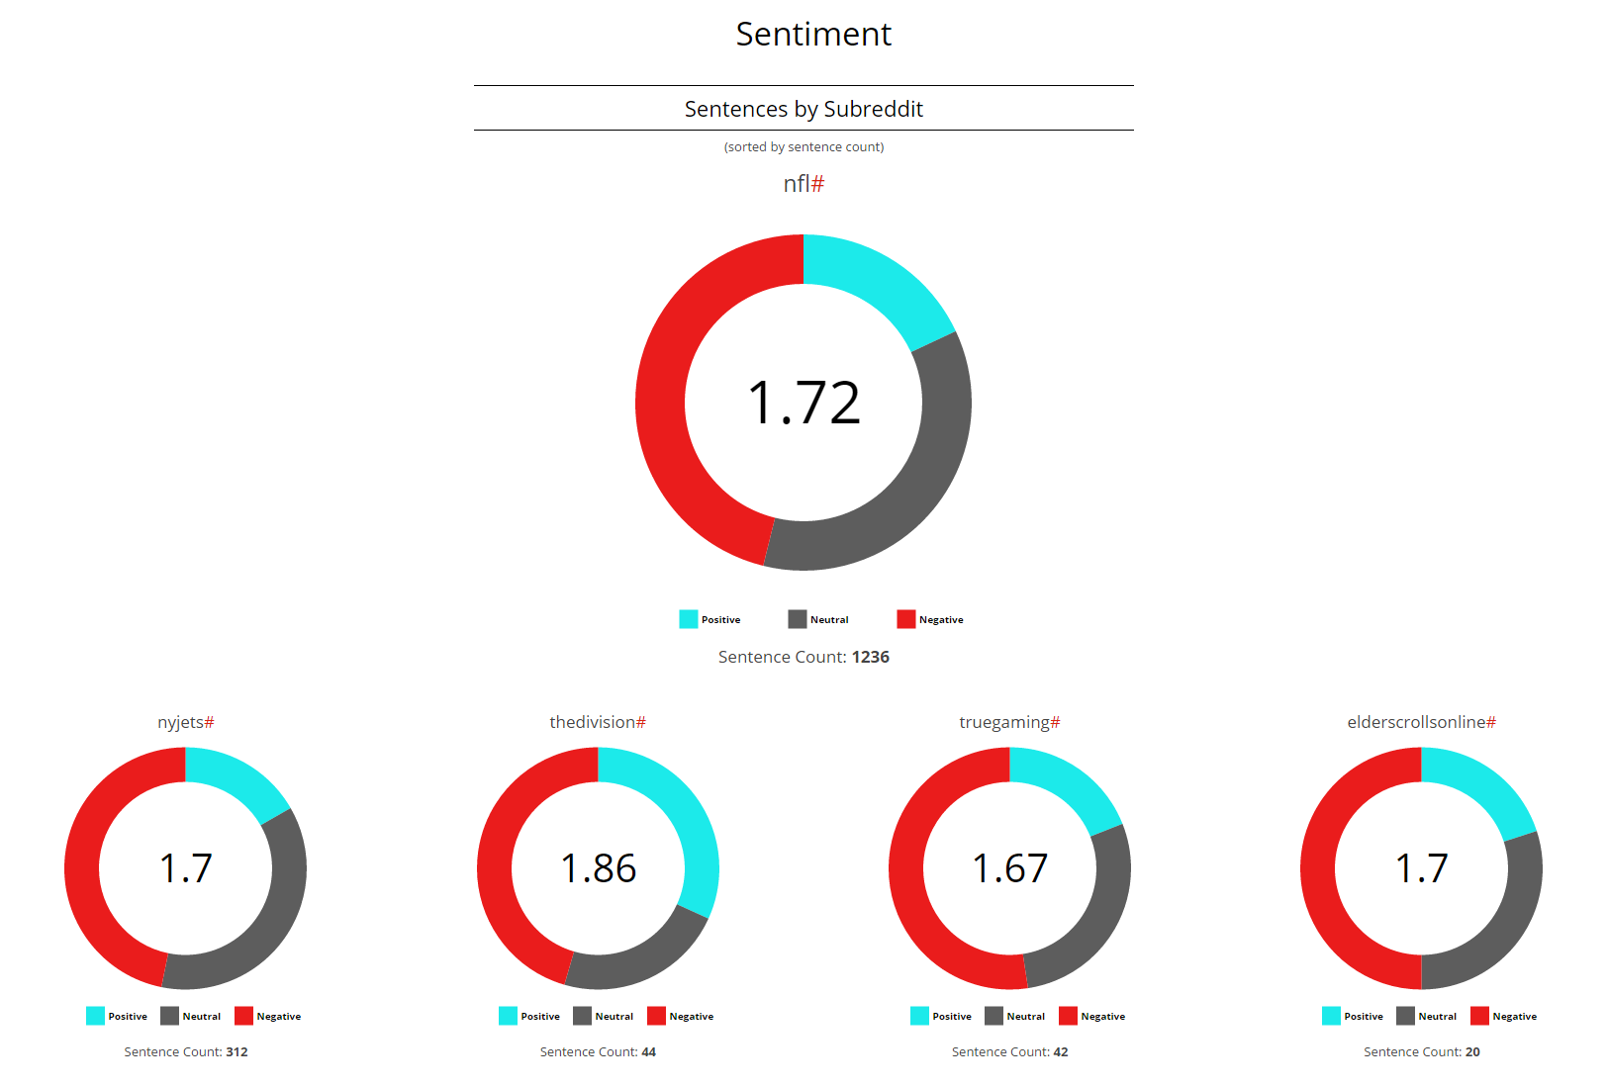
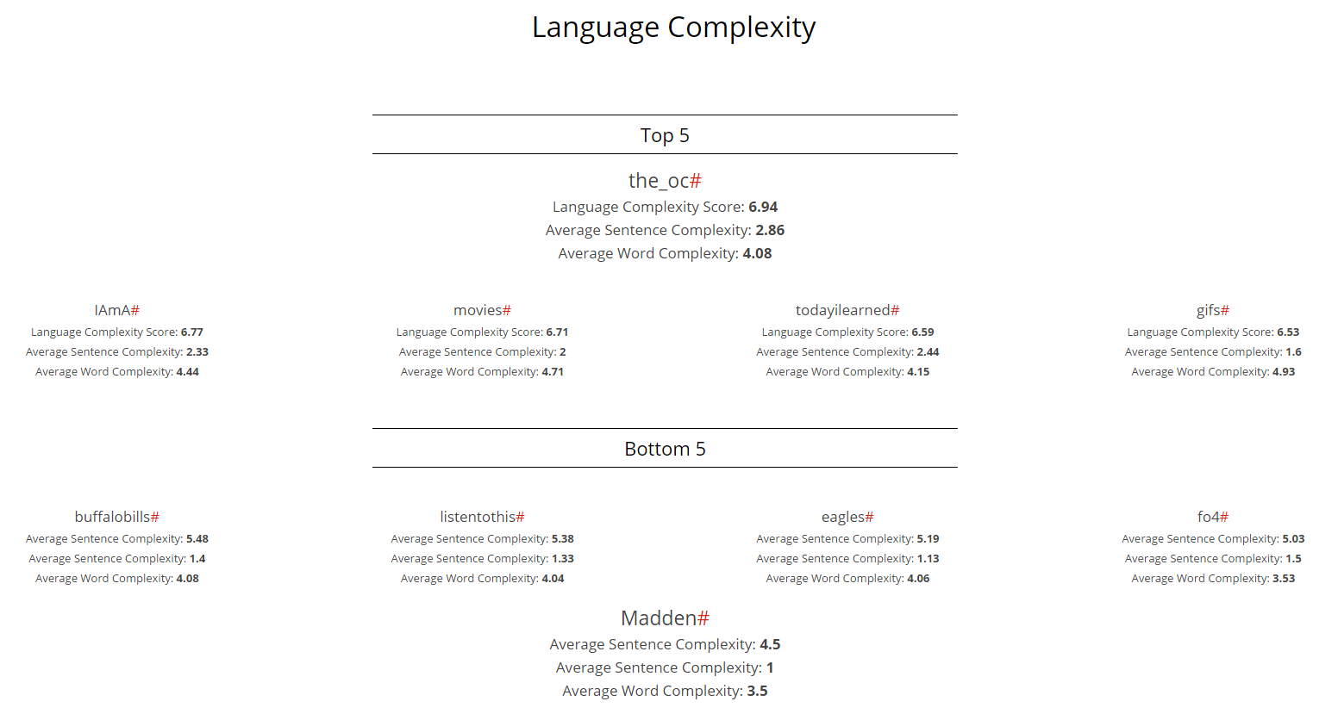
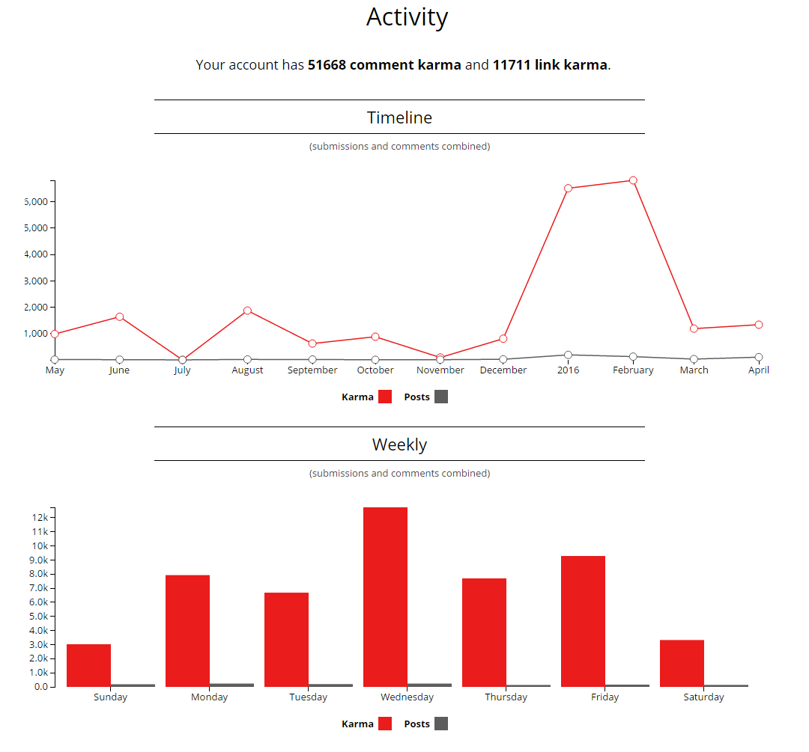
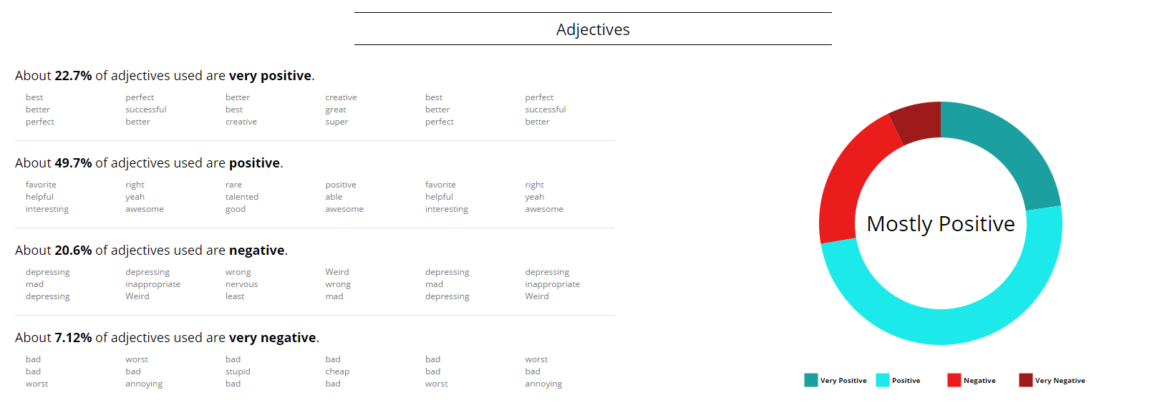

RedReaper
Julian Esteban, Kanav Tahilramani, Matthew Chatten, Sujay Bandarpalle
{x, x, x, x}@scarletmail.rutgers.edu
Advisor: Dr. Shantenu Jha
Project Number: S16-036
Goal
Methodology
Build a social media analysis tool for Reddit [3]
Gather publicly available content and metadata
Provide analysis of Reddit users and “subreddits”
Project was divided into two stages:
1. Group Stage
The team worked together to produce planning documents, brainstorm ideas for features, write early proposals, and build the basic framework of the website.
2. Individual Stage
Once a framework was built, individual team members turned to creating features suited to their strengths, ranging from NLP to front-end design to data collection.
General Software Practices:
Redreap is built to be a website running on the MEAN stack, which uses mongoDB, express, AngularJS, and NodeJS. The majority of the programming was done in Javascript.
The project was organized on a public Github repository.[1] Special care was taken to ensure that the software is extensible, allowing for individual team members to contribute their own features harmoniously.
Motivations and Objectives
Motivations
Make interesting, informative data and analysis available
Show users what can be revealed about them and their online communities through NLP and public data
Objectives
Build accurate, readable feature outputs for analysis
Provide wide variety of both content and metadata results
Results
Research Challenges
Choosing best framework for project
Chose to build website using the MEAN stack
Figuring out best approach for Natural Language Processing
Chose to use Stanford Open Source NLP tools for our own custom analyses [2]
Make improvements to performance
Use ample processing power, reduce database storage, increase efficiency of API calls and NLP processing
Acknowledgement
References
We would like to thank our advisor, Dr. Jha, for his help and advice throughout the project.
[1] "Vanak/red-reap." GitHub. N.p., n.d. Web. 19 Apr. 2016. <https://github.com/vanak/red-reap>.
[2] "Software." - The Stanford Natural Language Processing Group. N.p., n.d. Web. 19 Apr. 2016. <http://nlp.stanford.edu/software/>.
[3] "We Power Awesome Communities." Reddit.com: About Reddit. N.p., n.d. Web. 19 Apr. 2016. <https://www.reddit.com/about/>.

